Slide 1
Jewel or Counterfeit?
IC24 Project Management Team 13:
Carmen Beleho, Olaronke Afolabi, Ryan Collingham

Slide 2

What is “Jewel” ?
GreenStar's acquisition of Bluewave was largely attributed to a contract named "Jewel". However, tensions arose as GreenStar sought to impose its agile engineering methodologies onto Bluewave.
Ronke

Slide 3
Problem Statement
How does GreenStar, Inc. preserve the projected value of the Bluewave, Ltd acquisition investment, and especially the multi-billion-dollar, multi-year future value of the “Jewel” program?
Carmen

Slide 4
Strategic Action Plan for GreenStar, Inc.
Access the Situation
Communication and Collaboration
Gradual Transition
Customization and Flexibility
Verification
Incentives and Benefits
Mediation and Conflict Resolution
Ronke

Slide 5
Does GreenStar, Inc. being a publicly traded company have any effect on this situation?
GreenStar being a publicly traded company can have implications for how it handles the situation with Bluewave, particularly in terms of shareholder expectations, regulatory compliance, and financial performance.
Publicly traded companies are accountable to their shareholders, who expect them to make decisions that maximize shareholder value.
Shareholders and financial analysts will closely scrutinize the company's performance and any developments related to the acquisition and integration process.
Publicly traded companies are subject to various regulatory requirements, including securities laws, corporate governance standards, and disclosure obligations.
Questions to consider
Ronke

Slide 6
Does the annual revenue size of Bluewave Ltd impact how GreenStar handles this situation?
The annual revenue size of Bluewave Ltd can significantly impact how GreenStar handles the situation, particularly in terms of integration strategies, financial considerations, and risk management.
The size of Bluewave's revenue influences GreenStar's market positioning and competitive advantage. If Bluewave is a market leader or has a strong brand reputation, GreenStar may seek to capitalize on its market presence and customer relationships to drive growth and enhance its own market position.
GreenStar may need to allocate additional resources, expertise, and management attention to maximize the value of the acquisition, accelerate integration timelines, or pursue strategic initiatives that leverage Bluewave's strengths and capabilities.
Questions to consider
Ryan

Slide 7
How does development methodology affect GreenStar’s considerations on approach to a resolution?
The development methodology employed by GreenStar and Bluewave plays a crucial role in shaping the approach to resolving the conflict surrounding the integration of their methodologies for executing the "Jewel'' contract.
Development methodologies often reflect underlying cultural norms, values, and practices within an organization.
The choice of development methodology can have significant implications for business outcomes, including project delivery timelines, product quality, customer satisfaction, and return on investment.
Development methodologies influence how stakeholders, including project teams, customers, and executives, engage and collaborate throughout the project lifecycle.
Questions to consider
Carmen

Slide 8
How could organizational change management techniques benefit both GreenStar and Bluewave?
Organizational change management techniques can benefit both GreenStar and Bluewave in several ways.
By keeping employees informed about the reasons for change, the expected outcomes, and the timeline for implementation, both GreenStar and Bluewave can reduce uncertainty and resistance to change.
Change management involves providing training and development opportunities to help employees adapt to new processes, tools, and methodologies.
By fostering an inclusive and collaborative culture that values diversity of thought and experience, both organizations can harness the collective strengths of their employees and build a unified organizational identity.
Questions to consider
Ronke

Slide 9
Access the Situation: Methodology Comparisons
Agile/Iterative
Waterfall/Predictive
More adaptable and responsive to changes.
More structure and predictability, reducing the likelihood of scope changes and associated disruptions.
Results in greater stakeholder satisfaction and value delivery over time.
Struggles to accommodate changes effectively
Ryan

Slide 10
Customization and Flexibility
Instead of imposing GreenStar's methodologies outright, work with Bluewave to tailor agile methodologies that integrate elements of both organizations' approaches. This hybrid approach can leverage the strengths of both methodologies while minimizing disruption to ongoing projects
Ronke

Slide 11
95%
Effects of Incentives on Employees Productivity
Confidence interval of professional practices that aim to reward and compensate their workers
Carmen

Slide 12
Mediation and Conflict Resolution
Establish a unified governance structure for the "Jewel" program that incorporates input from both GreenStar and Bluewave leadership teams.
Define roles, responsibilities, and decision-making authority to streamline operations and mitigate potential conflicts.
Ryan

Slide 13
“Jewel” Management Plan
Stakeholders
Involve key stakeholders from both GreenStar and Bluewave in the decision-making process regarding the adoption of methodologies for the "Jewel" program.

Slide 14
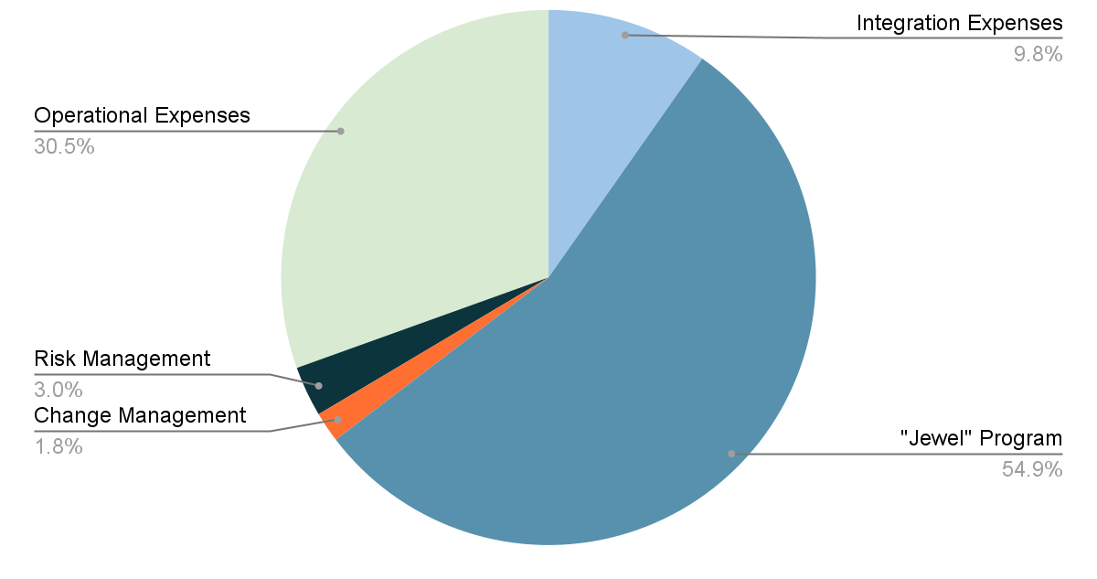
“Jewel” Management: Budget Plan
Stakeholders
Total Budget: 1.64B
Carmen

Slide 15
Change Management Plan
PC
RM
Risk Management
Planning & Communication
P
T
Culture Integration
CI
LA
Leadership Alignment
E
L
Process Integration
S
Continuous Improvement
PI
E
CI
Ryan

Slide 16
Business Impact Analysis Matrix
Agile/Iterative (GreenStar):
Low Business Impact:
Flexibility in adapting to changes in project requirements.
Continuous delivery of incremental value.
Improved stakeholder satisfaction due to regular feedback loops.
Medium Business Impact:
Potential for minor delays in project timelines due to iterative nature.
Moderate increase in project costs due to ongoing adjustments and iterations.
Some resistance from stakeholders accustomed to traditional project management methodologies.
High Business Impact:
Significant disruption in project progress if key Agile principles are not followed.
Loss of stakeholder confidence if frequent changes lead to uncertainty or confusion.
Increased risk of scope creep if requirements are not effectively managed.
Waterfall/Predictive (Bluewave):
Low Business Impact:
Clear and structured project plans from the outset.
Minimal need for ongoing adjustments once project execution begins.
Predictable project timelines and budgets if requirements are well-defined.
Medium Business Impact:
Potential for moderate delays if requirements change during project execution.
Increased risk of scope changes leading to additional costs.
Limited flexibility to accommodate stakeholder feedback or evolving market conditions.
High Business Impact:
Significant delays and cost overruns if initial requirements are incomplete or inaccurate.
Decreased stakeholder satisfaction due to lack of visibility and opportunities for feedback.
Higher likelihood of project failure if changes are poorly managed or not accommodated.
Ronke (rush through)

Slide 17
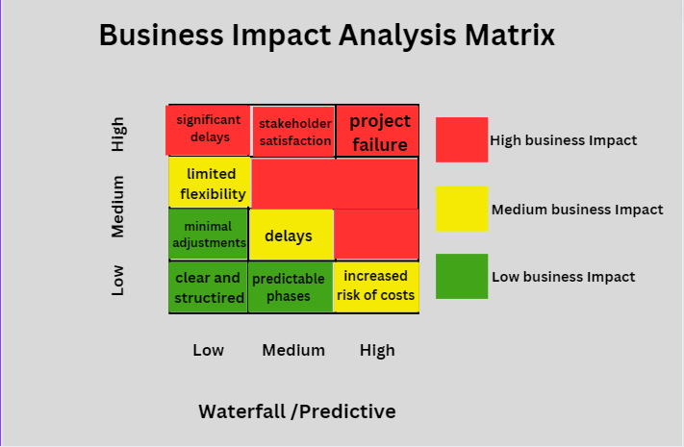
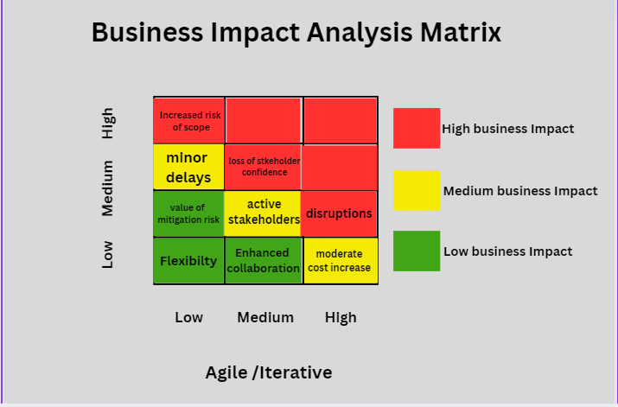
Risk Management
Ronke

Slide 18
Comparison
Agile/Iterative methodology is more adaptable and responsive to changes, which can mitigate risks associated with evolving project requirements, whereas Waterfall/Predictive methodology provides more structure and predictability, reducing the likelihood of scope changes and associated disruptions.
Agile/Iterative may lead to higher initial costs and potential delays but can result in greater stakeholder satisfaction and value delivery over time, while Waterfall/Predictive may offer more predictability but could struggle to accommodate changes effectively.
Ronke

Slide 19
Questions?

